Slide 1
Sustaining accessibility: accessibility-related appraisal objectives
Matthew Deeprose
Tamsyn Smith
Notes:
Tamsyn: Good afternoon! We’re here to discuss a piece of work we have recently started the University of Southampton, “accessibility-related appraisal objectives”.

Slide 2
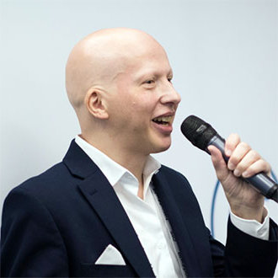
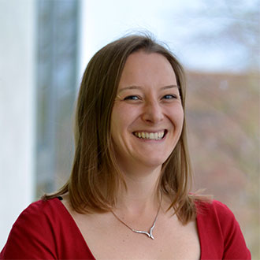
Who we are
Matthew Deeprose
Senior Learning Designer
University of Southampton
Tamsyn Smith
Senior Learning Designer Team Lead
University of Southampton
Notes:
I’m Tamsyn Smith , Senior Learning Designer Team Lead at University of Southampton, and I’m joined by my colleague Matthew Deeprose, Senior Learning Designer

Slide 3


You are the resistance
© Columbia Pictures
Notes:
Matt: Thanks for inviting us to join you on Global Accessibility Awareness Day.
[Progress]
As Christian Bale says in the film Terminator Salvation, ”If you're listening to this, you are the resistance”.
It often feels that those of us with an interest in accessibility are part of a resistance, aiming to reduce and remove inaccessible practices and unnecessary barriers that prevent people from making the most out of the potential of our digital estate.
No doubt many of you have experienced advocacy fatigue. Pointing out simple issues like focus indicators, focus order, colour contrast, alternative text for the umpteenth time can wear you down.
But we want to move from resistance into the mainstream, we want every one to care and be interested, we want considering accessibility to become second nature.

Slide 4



Agenda
Describe the context
Our concept: accessibility-related appraisal objectives
Next steps
Notes:
In this session, we’re going to talk a little about this context. We appreciate that our presentation may be of more interest to the “accessibility geeks” among us, so we’ll use this section to try to give some pointers to useful resources for those new to this area.
[Progress]
Then share our early thinking of an idea we are developing, aiming to embed accessibility more into the culture of our IT department. Through creating accessibility related appraisal objectives for a variety of roles.
[Progress]
And then talk about some next steps, share with you the work we have done so far and invite you to share feedback and build on this early work.

Slide 5
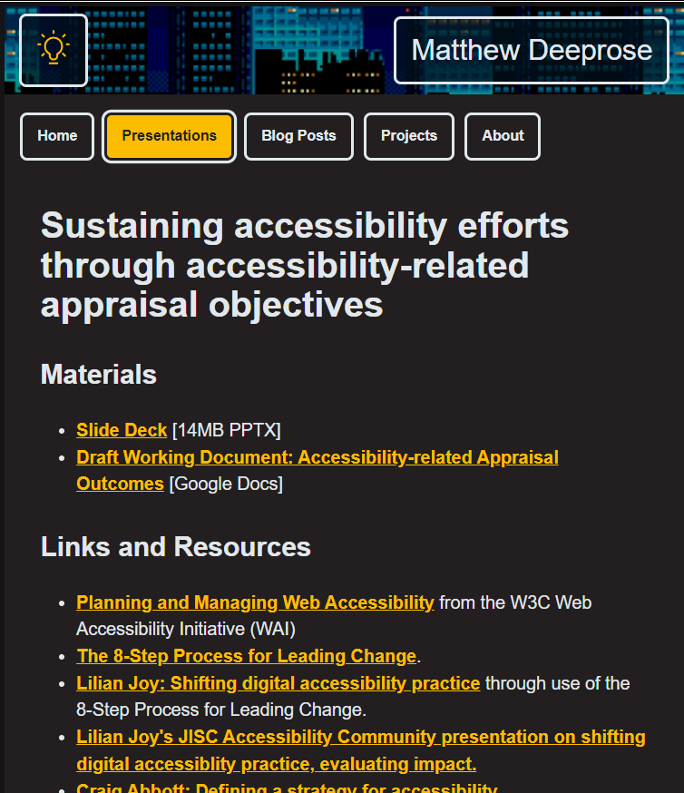
Resources
https://matthewdeeprose.github.io/objectives.html
Notes:
The slide deck, links and resources we cover in this session are online and we’ll be pasting this link in the chat.

Slide 6
UoS IT accessibility maturity scorecard
Criteria | Yes / No
IT accessibility policy / strategy | ☒ No
Accessibility considered in procurement | ☑ Yes
Accessibility knowledge required in developer job descriptions | ☑ Yes
Accessibility testing as part of change / release process | ☒ No
KPIs or other metrics for accessibility | ☒ No
Accessibility community of practice | ☑ Yes
Established accessibility testing process | ☒ No
Accessibility training relevant to IT roles | ☒ No
Leadership buy-in for accessibility | ☑ Yes
Notes:
Every institution is at some point in its accessibility journey. We work in the University of Southampton IT department and to give you an idea of where we are at, while we don’t have an IT accessibility policy, accessibility conformance is part of our non-functional requirements for procurement of new services, we have accessibility knowledge and skill as requirements for developer roles, we don’t have accessibility testing as part of our change and release process and are not measuring nor reporting on accessibility. We have a fairly well established accessibility community of practice, but don’t have an established accessibility testing process, nor training specific to different types of roles. We do have buy-in for accessibility from our leadership group to some extent at least.

Slide 7


So what does that look like?
Community of Practice growing from the ground up.
Introducing Ally in the Education context raised awareness.
Ad-hoc requests for accessibility consultancy.
New IT services launched with accessibility issues.
Limited approach to CDDO letter.
Initiative fatigue?
Notes:
What does that look like for us in our IT department. First we can only talk from our own experiences, but on the positive side we have seen our internal digital accessibility community of practice grow to include about 20% of our department as members.
Through introducing Blackboard Ally in the educational context we have raised awareness of accessibility further even within our IT department.
And we find ourselves receiving ad-hoc requests and enquiries relating to accessibility. Showing that some are realising this needs to be considered, but of course it’s coming at the proofing stage, rather shifting-left to the initial requirements and design stages.
[progress]
On the other side, without checking for accessibility as part of our change and release process new IT services are being launched with accessibility issues that are not logged or prioritised. Building accessibility debt that will have to be paid off later, with interest.
Like many institutions we received our letter from the central digital and data office for not meeting our responsibilities under the accessibility regulations. While a lot of the issues identified were already on the roadmap for improvements to our corporate site, thanks to the massive project to transform our corporate site led by our colleague Ayala Gordon. We had hoped it would start a wider conversation in our IT department about how to avoid introducing such issues across our whole digital offering. For the moment it seems that very few people in our department are aware that the government has contacted us.
We need to acknowledge initiative fatigue. Our colleagues have been through a lot over the last few years. And now we have new strategies, new initiatives, and the same amount of time to get everything done. Telling people “here’s more work you’ve not got time for” is not going to go down well, however well-intended.

Slide 8
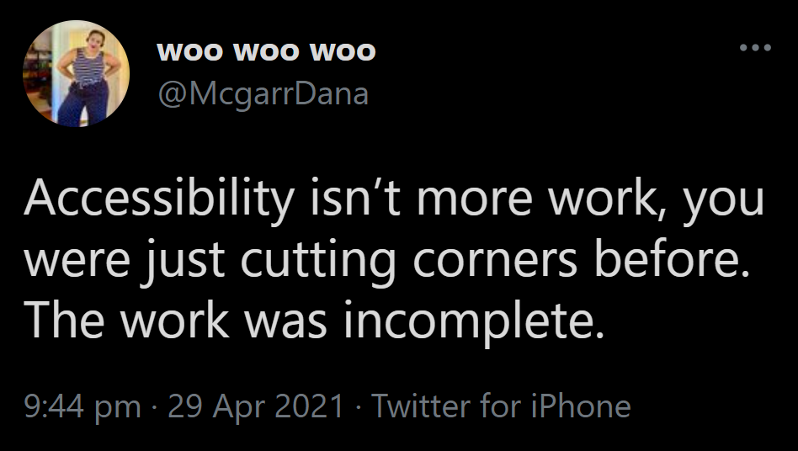
More work?
Notes:
On the topic of “more work” I always like to refer to this tweet, Accessibility isn’t more work, you were just cutting corners before. The work was incomplete. This is particularly relevant for a professional IT department.
https://twitter.com/McgarrDana/status/1387870476178006020

Slide 9

What do we mean by sustaining accessibility?
Notes:
You might often hear people in the accessibility community talk about “sustaining accessibility”

Slide 10
Planning and Managing Web Accessibility 1
Initiate
Implement
Sustain
Plan
Notes:
It’s the fourth point on the Planning and Managing Web Accessibility” pathway from the Worldwide Web Consortium, W3C
Here, sustaining accessibility is about maintaining the momentum of our accessibility efforts.
https://www.w3.org/WAI/planning-and-managing/

Slide 11
Kotter’s Eight Steps
Create
Create Urgency
Form
Form a Powerful Coalition
Create
Create a Vision for Change
Communicate
Communicate the Vision
Remove
Remove Obstacles
Create
Create Short-Term Wins
Build on
Build on the Change
Anchor
Anchor the Changes in Corporate Culture
Notes:
Looking at another framework, Lilian Joy at the University of York has done some brilliant work demonstrating how Kotter’s 8 Steps can be used as a framework for shifting digital accessibility practice. The last of those steps is about anchoring changes in corporate culture.
So embedding a change is departmental culture is really important.

Slide 12
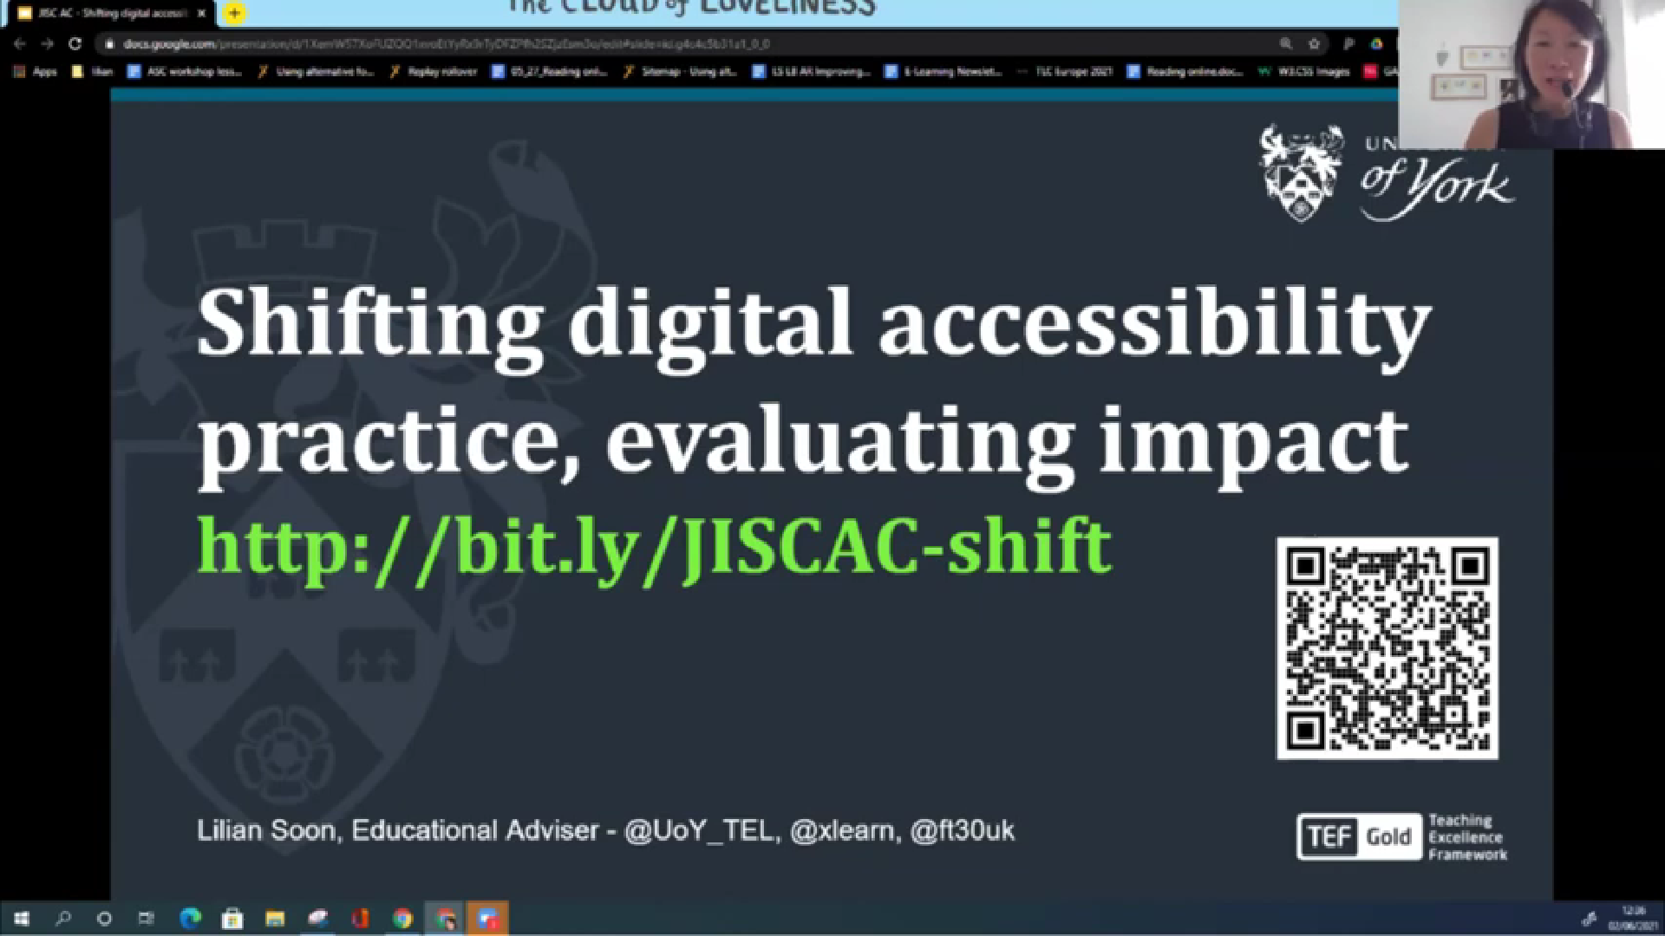
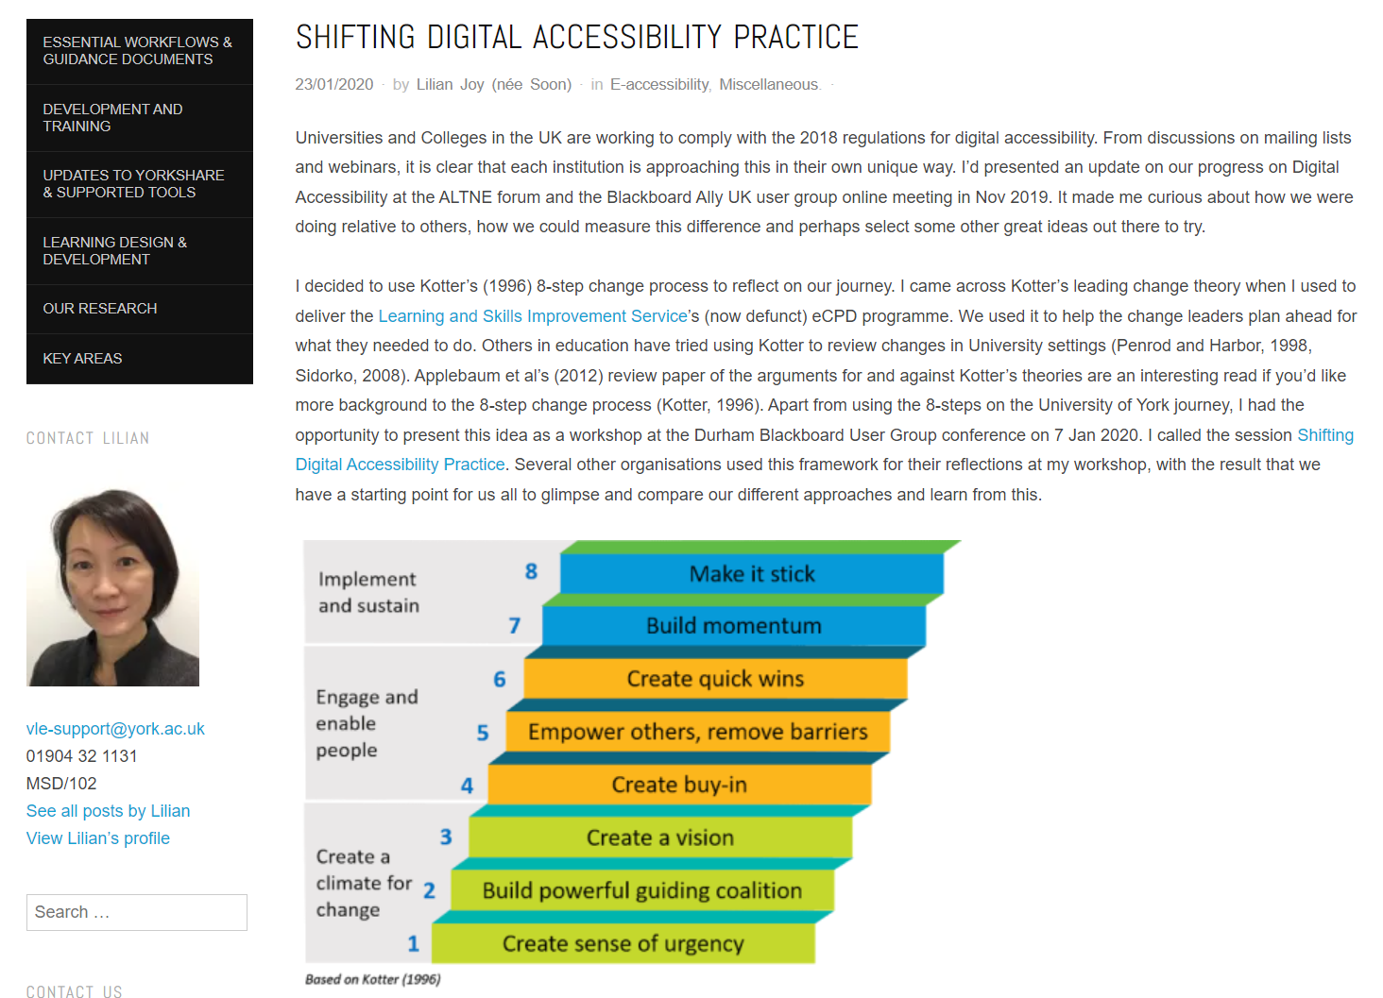
Lillian’s resources
Notes:
If you would like to learn more about Lilian’s work you can watch her presentation to the JISC accessibility community in a recorded webinar and read more about it on the University of York website.
https://youtu.be/kt_gCW6BEhs
http://bit.ly/eaccess-shifting

Slide 13
Craig Abbott’s 3 pillars of accessibility
Compliance
Culture
Education
Craig Abbott’s three pillars of accessibility
Notes:
Continuing our thoughts about culture.
Craig Abbot from the Department of Work and Pensions has recently published a blog post sharing his three pillar’s of accessibility. He writes that, “There are 3 core parts. Compliance, education, and culture. If you lack any of these 3 things over a sustained period of time, the strategy is unsustainable and your ability to consistently deliver accessible services will burn out.”

Slide 14
Craig Abbott’s 3 pillars of accessibility 2
Compliance
Culture
Education
Craig Abbott’s three pillars of accessibility
Notes:
This mirrors Kotter’s eighth step.

Slide 15
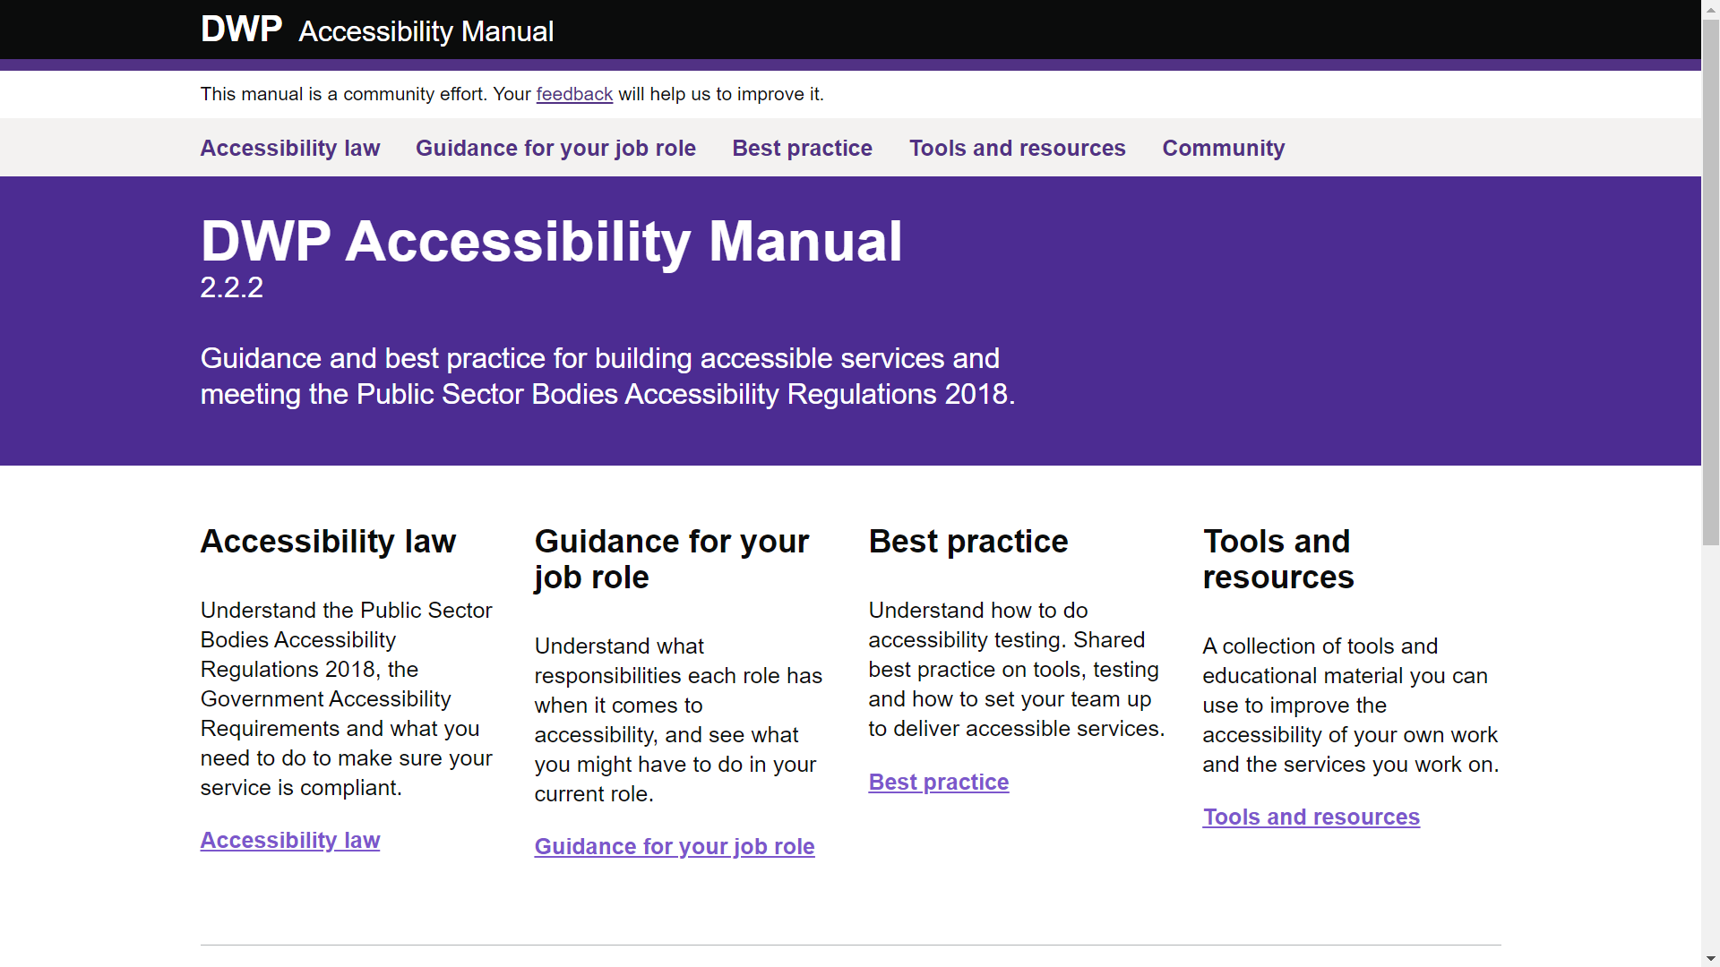
DWP accessibility manual
Notes:
On the topic of the DWP it’s worth looking over their Accessibility Manual which is a really useful resource.

Slide 16
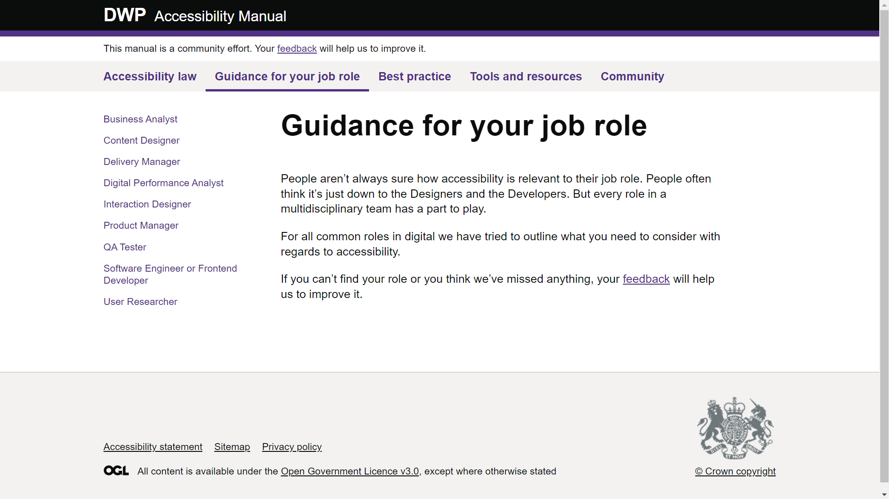
DWP Guidance for your job role
Notes:
They have a section that relates accessibility to different job roles, which also aligns with some of the work we’ll be talking about shortly.

Slide 17


Accessibility skills are in demand
Less than 3% of University tech programmes include accessibility. *
63% of tech companies cannot staff accessibility needs. **
93% say demand for accessibility skills will increase in the future **
The number of job listings with “accessibility” in the title increased by 78% in the year ended in July from the last 12 months. ***
* Teach Access Institutions course list (coded), 2018
** Accessible Technology Skills Gap Report, PEAT, 2018.
*** Wall Street Journal, 2021
Notes:
Back to the context.
As George mentioned on Monday, Accessibility skills are in demand.
While Teach Access found that very few University tech programmes include accessibility
The Partnership on Employment & Accessible Technology did research that found that 63% of tech companies were unable to staff their accessibility needs and 93% expected that demand for accessibility skills would increase. Last year, the Wall Street Journal wrote that accessibility job listings had increased by 78%.
So, accessibility skills are in high demand. Universities tend to have a lower turnover than the private sector but we will face the need to keep up that pipeline of maintaining staff with good knowledge of accessibility, which again will reflect into our organisation culture.

Slide 18
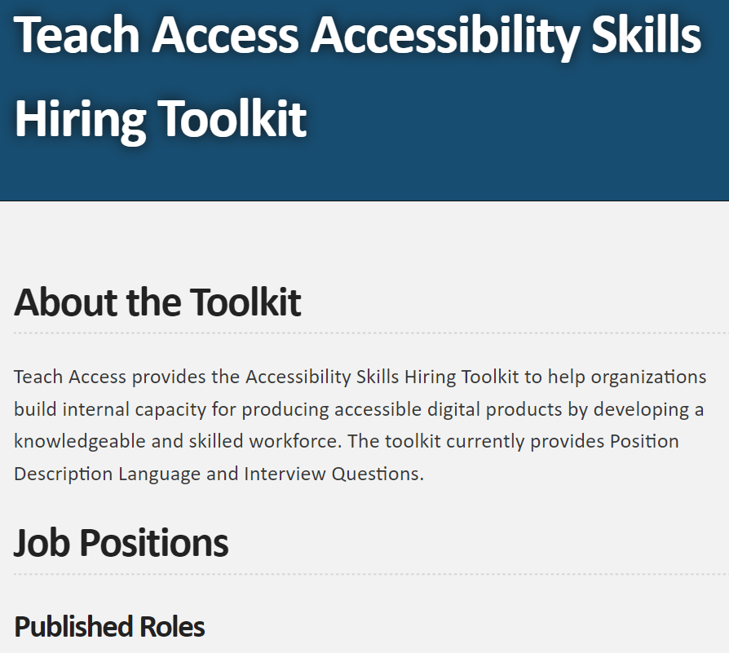
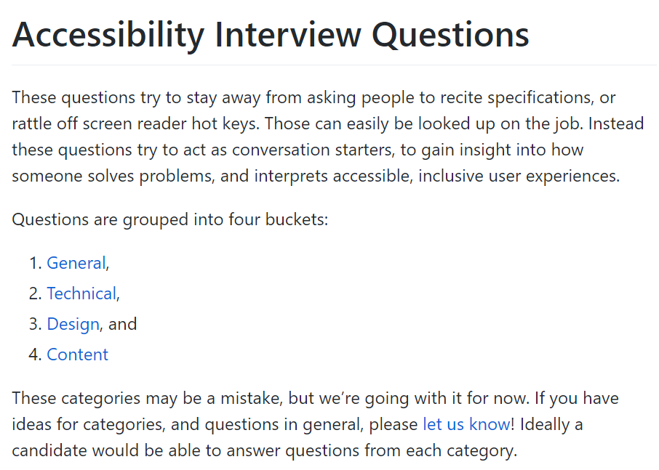
Examples
Notes:
On that topic here’s some resources to be aware of, Teach Access provides an Accessibility Skills Hiring Toolkit,
[progress]
and Scott O’Hara has created a list of Accessibility Interview Questions for different types of roles.

Slide 19
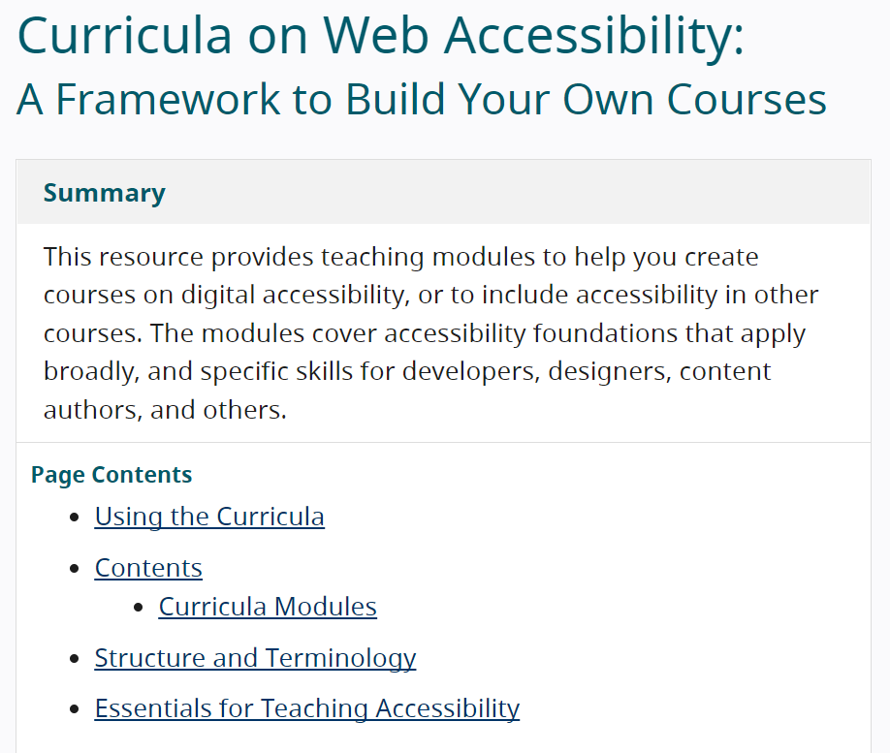
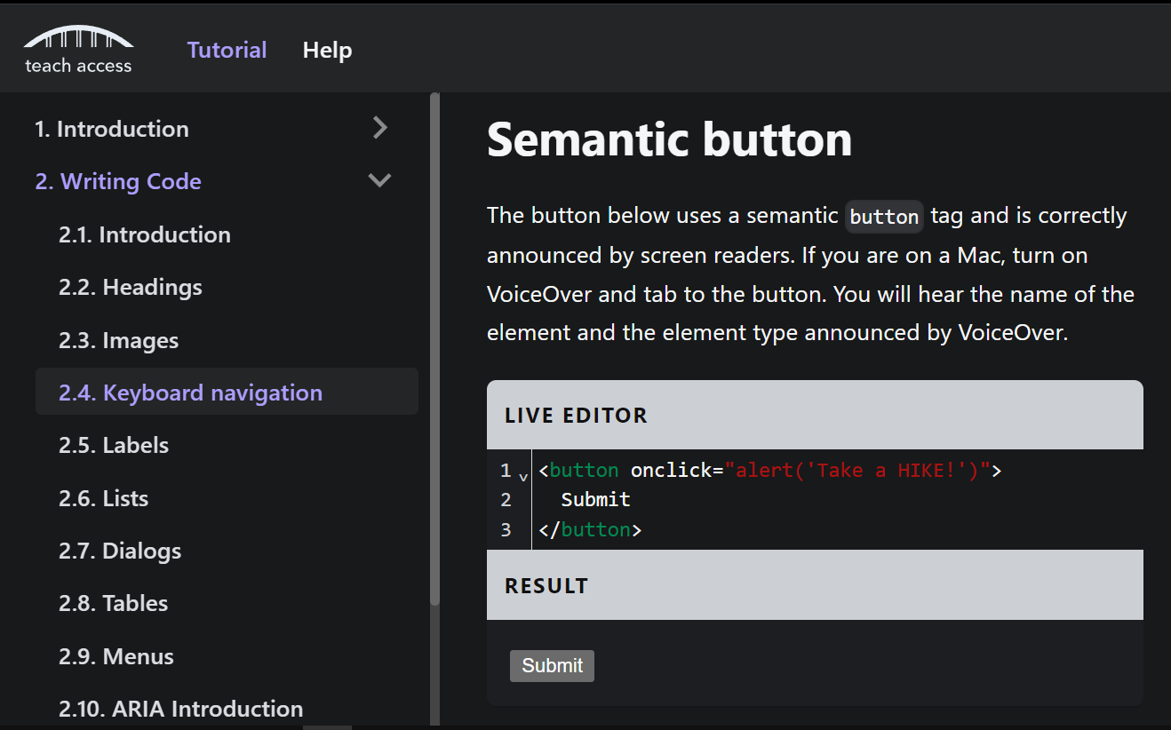
Examples 2
Notes:
The W3C provides a framework for building your own accessibility training courses,
[progress]
and Teach Access has a tutorial aimed at developers that covers some of the basics.

Slide 20
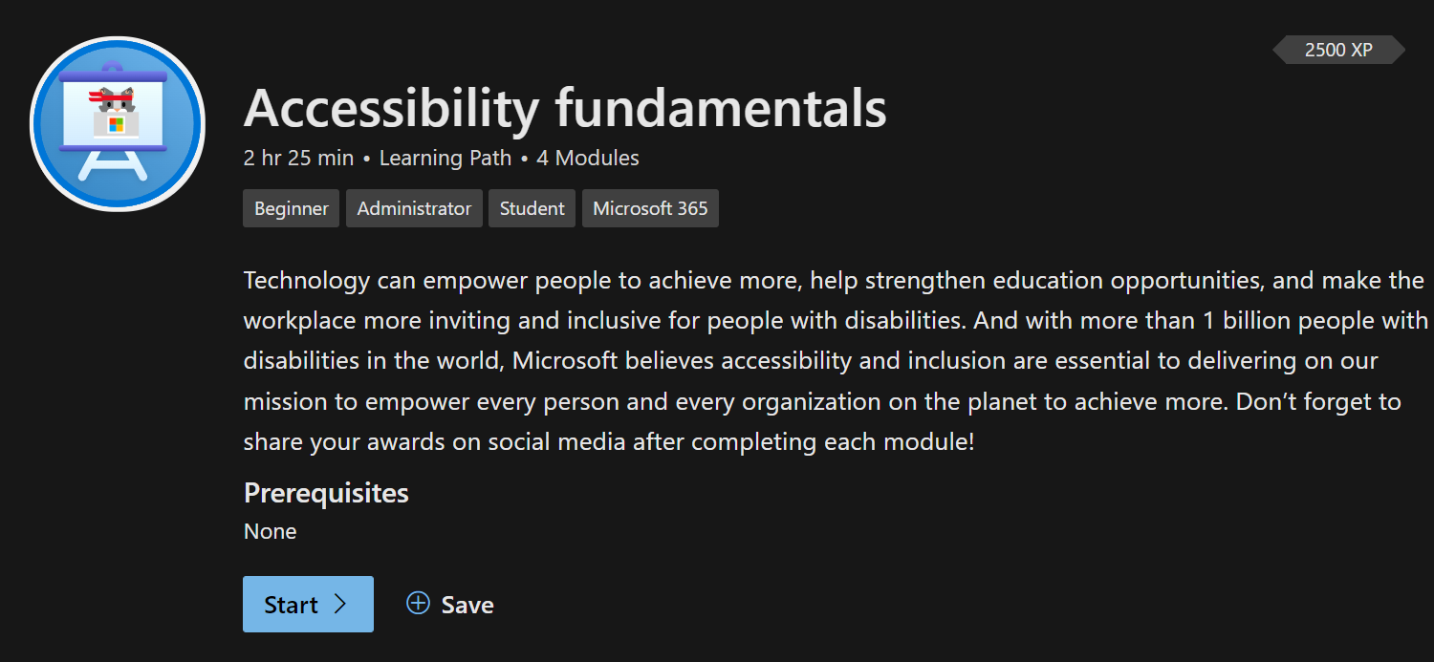
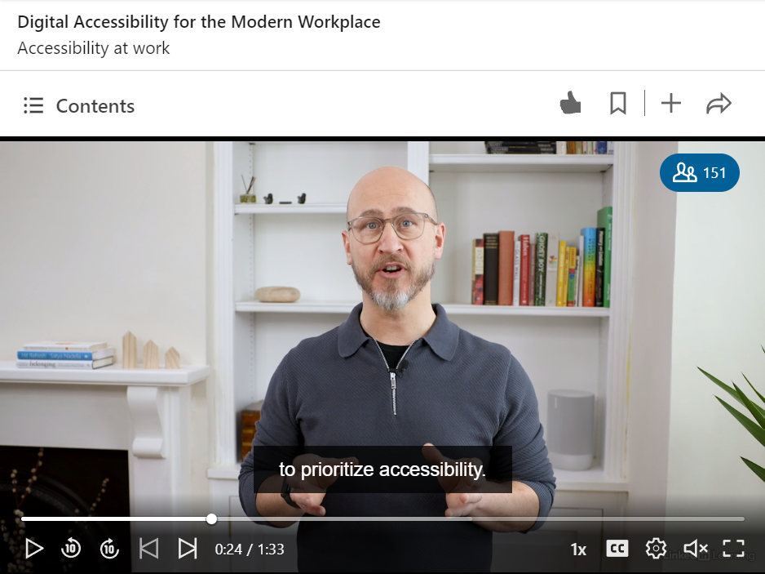
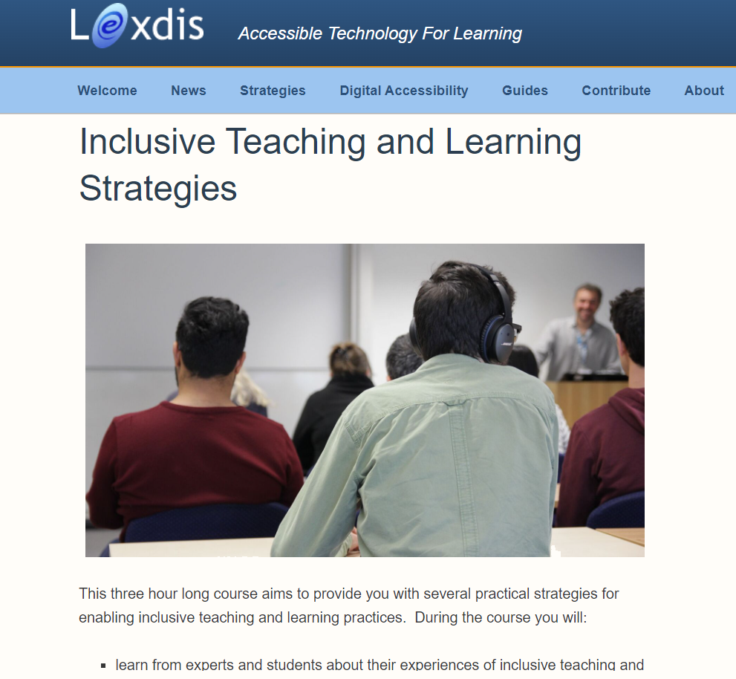
More training resources
Notes:
For generalists, Microsoft have created an Accessibility Fundamentals learning path,
[progress]
and Hector Minto from Microsoft has a very practical LinkedIn Learning course about accessibility in the modern workplace.
[progress]
For educators, Lexdis has a very useful online course for Inclusive Teaching and Learning Strategies.
https://docs.microsoft.com/en-us/learn/paths/accessibility-fundamentals/
https://www.linkedin.com/learning/digital-accessibility-for-the-modern-workplace/accessibility-at-work
https://www.lexdis.org.uk/course/inclusive-teaching-and-learning-strategies/

Slide 21

Reaching across the organisation
“As a database manager my job is to make things as inaccessible as possible.”
Notes:
We need to reach out across our IT organisation to build that culture and awareness.
I’m sure many of you will have encountered colleagues thinking accessibility is about Identity Management and Service Access. It’s a recurrent theme in our department to explain what we mean by accessibility. For example a database manager recently told us “my job is to make things as inaccessible as possible.”

Slide 22

Reaching across the organisation 2
“No, I never tested the corporate site with a keyboard”.
Notes:
And in discussions with our communication platforms manager, he said he hadn’t tested the corporate site platform for which his team is responsible with a keyboard.

Slide 23

What do we mean by sustaining accessibility? 2
Notes:
So, when we talk about sustaining accessibility we’re thinking about how to keep momentum. Even without a formal accessibility policy, we can increment further by building an organisational culture that considers accessibility.

Slide 24
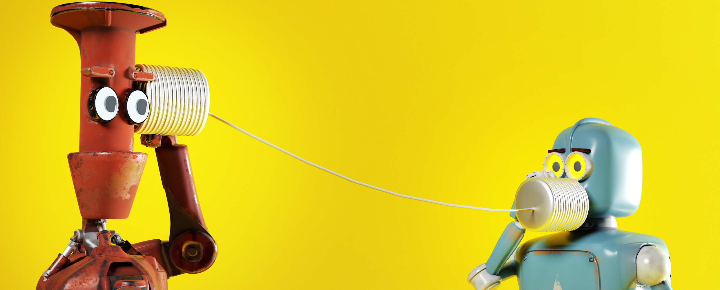
What opportunities are there every year?
Notes:
Tamsyn: What opportunities are there each year? Most institutions are likely to run annual performance reviews with staff, reflecting on the past year’s outcomes and setting objectives for the year ahead. You might call these appraisals, personal development reviews, or something else. Typically no one enjoys writing objectives. What if we could give people some ready made objectives, designed to raise awareness and understanding of accessibility in the IT department, helping to create that organisational culture?
IT departments have particular attributes, they are responsible for most, if not all, of the University’s digital estate, so implementing technical solutions that meet accessibility guidelines can only really be done by the IT department. They tend to be embedded within their institution, touching almost all aspects, and are often looked to for leadership. We’re based in our IT department, but these principles can be applied elsewhere as well.

Slide 25




The idea
Create a bank of accessibility-related appraisal objectives.
Based on different types of role, e.g., technical roles, support roles, administrative roles.
Can be used as is or customised.
Based on different levels of accessibility awareness and skill of the individual.
Aiming toward building up to aspects of the “partnership” level of maturity identified in McNaught / AbilityNet accessibility maturity model.
Notes:
So, the idea is to create a “bank” of accessibility-related appraisal objectives.
[Progress]
That can be used “as is” or customised.
[Progress]
Appropriate for different types of role, we’ve been focusing on generalists, developers, and system support roles.
[Progress]
At different levels of accessibility awareness and skill, suitable for whatever stage an individual is at.
[Progress]
Ultimately aiming at steering towards the “partnership” level of maturity identified in the McNaught / AbilityNet accessibility maturity model.

Slide 26
Roles
Universal
Developers
Support Specialists
Other *
Notes:
We’ve broken them down into different types of IT role.
First, those that apply for any role: Universal or generalist.
Developers will have certain responsibilities for accessibility, and also have knowledge of accessibility as a requirement in their job descriptions, so we need something for them.
We have a large number of application support specialists who are answering tickets, planning upgrades, writing documentation and so on. They also are responsible for service roadmaps. So we need to consider something for them.
And other roles like business analysts, project managers, and so on may be dealing with vendors, planning out projects and so on, so we might have a small number of objectives specific to certain other roles.

Slide 27
Stages / Levels
4
3
General awareness
Discovering
Exploring
Advocating / Championing
2
1
Notes:
We have four levels or stages:
General awareness
Discovering - focussing more on applying knowledge, building skill, and exploring potential for improving accessibility within a colleague’s area of influence.
Exploring - aiming for a deeper understanding of accessibility and it’s potential application and asking colleagues to collaborate with users with impairments and disabilities.
And advocating or championing

Slide 28
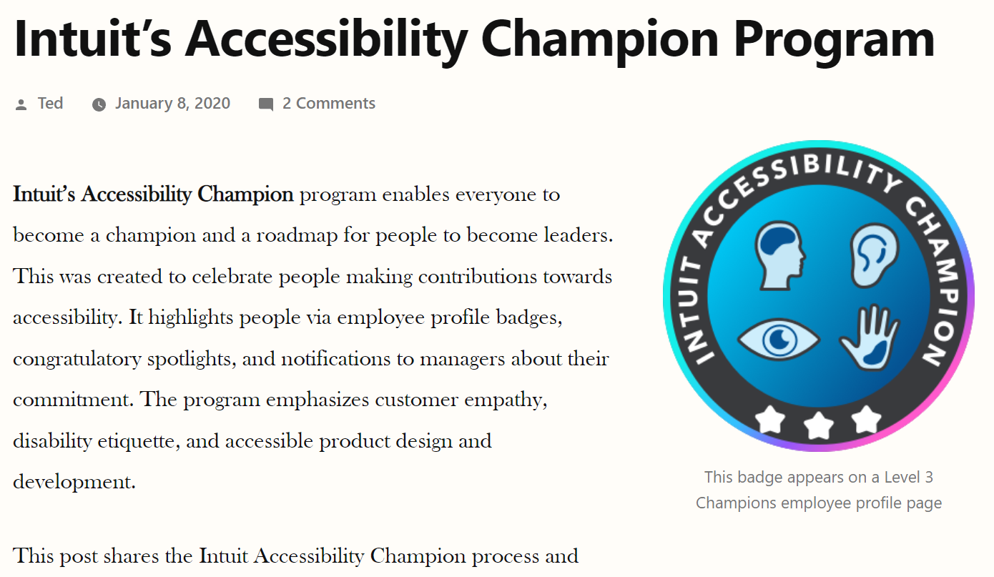
Four levels?
Notes:
By the way, the American company Intuit has an accessibility champion programme that also has four levels. If you haven’t come across this before we recommend Ted Drake’s blog post that explains how it works. He lists lots of different tasks for those at each level and there’s lots of great ideas in his post.
https://www.last-child.com/intuits-accessibility-champion-program/

Slide 29
What types of activities are under each stage?
General awareness
Basic training
Discovering
Exploring
Advocating / Championing
Reviewing VPATs / accessibility statements.
Learning how to run simple accessibility tests.
Prioritise accessibility defects.
Create / review an accessibility statement.
Working with service users who have an impairment or disability.
Speak at an external event about accessibility.
Observe how your team culture reflects inclusive practices and suggest improvements.
Refactor a component for accessibility.
Share your experiences with another team.
Notes:
Here’s some examples of different types of high-level activity included in these objectives, we’ve mixed in objectives for different role types.
At the first level of General awareness, we have:
Basic training – we have a generic training resource, and links to further content on LinkedIn Learning and Microsoft Learn, as well as those resources from Teach Access and LexDis we mentioned earlier.
Reviewing Vendor Voluntary Product Assessment Templates (VPATs) and accessibility roadmaps or local accessibility statements. To find out HOW what you learn in the abstract applies directly within the services you support.
Observing how your team culture, for example online or hybrid meetings reflect inclusive practices and suggesting improvements. As you learn some of these basics it might be interesting to see how they apply in activities like team meetings.
At the Discovering level, you might be
Learning how to run simple accessibility tests, perhaps based on the W3C’s quick checks.
Creating or reviewing an accessibility statement. I know we have hundreds of statements that need writing. Ben at UCL is doing some interesting work on making this process easier.
Accessibility can be really daunting when you are new to it. Prioritising accessibility defects can be a good way to identify what’s important to fix first, and perhaps to start thinking about how to avoid such issues in the first place. The Agile Accessibility Handbook has an excellent methodology for prioritising accessibility defects.
At the exploring level
Working with service users who have an impairment or disability. This could be in terms of understanding current issues, consulting on new developments, or learning about assistive technology use, or examples of barriers that they face.
For developers, refactoring a component to fix or improve accessibility issues whilst maintaining functionality should lead to learning opportunities for understanding better how such issues were introduced in the first place and lead to thinking about stopping them from reoccurring.
For Advocating / Championing we’re thinking about moving beyond the team level and talking to others, perhaps even outside of the institution.

Slide 30
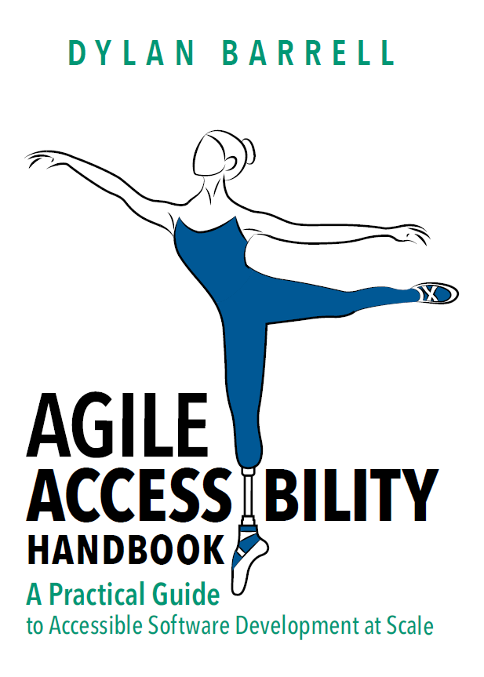
Agile Accessibility Handbook
Notes:
By the way, we mentioned the agile accessibility handbook in our last slide. If you’ve not read this book it’s a very practical guide to implementing accessibility within an IT department. It’s less than 100 pages and the electronic version is available free of charge.
https://accessibility.deque.com/agile-accessibility-handbook

Slide 31
Headings of each objective
Title
Category
Description (SMART)
What you might do to achieve this
Notes:
The structure of our draft document is…
a title, we’ve only been sharing some example titles so far.
The category aims to match one of the three categories for appraisal objectives in our HR system.
The description is meant to be a SMART objective, so that’s specific, measurable, achievable, relevant, and time-boxed.
What you might do to achieve this is more open and suggestive.
So far it’s been difficult to differentiate the description and the what you might do sections so we may revise these.

Slide 32
Basic content
Do
Discuss a service your team supports with a user who had a disability or impairment.
in order to
Identify what works well or not so well.
and
Suggest an action plan to improve the user experience and discuss with the team and user community.
Gain a better understanding of the types of barriers the user faces.
Notes:
The idea is not just to do the activity but to do it for a reason and having the outcome feedback into the team or department in someway, hopefully building a virtuous circle.

Slide 33
Example
Do
Discuss a service your team supports with a user who has a disability or impairment.
in order to
Identify what works well or not so well.
and
Develop an action plan to improve the user experience and discuss with the team and user community.
Gain a better understanding of the types of barriers the user faces.
Notes:
For example, discussing a service your team supports with a user who has a disability or impairment,
In order to identify what works well or not so well. And gain a better understanding of the types of barriers the user faces.
With an outcome of developing an action plan to improve the user experience and discuss that with the team, business owner and user community.
----
Give ppl 2 mins to write an accessibility challenge and share in chat?
As I ________
I will _________
In order to ________
and then with my team we will ________

Slide 34
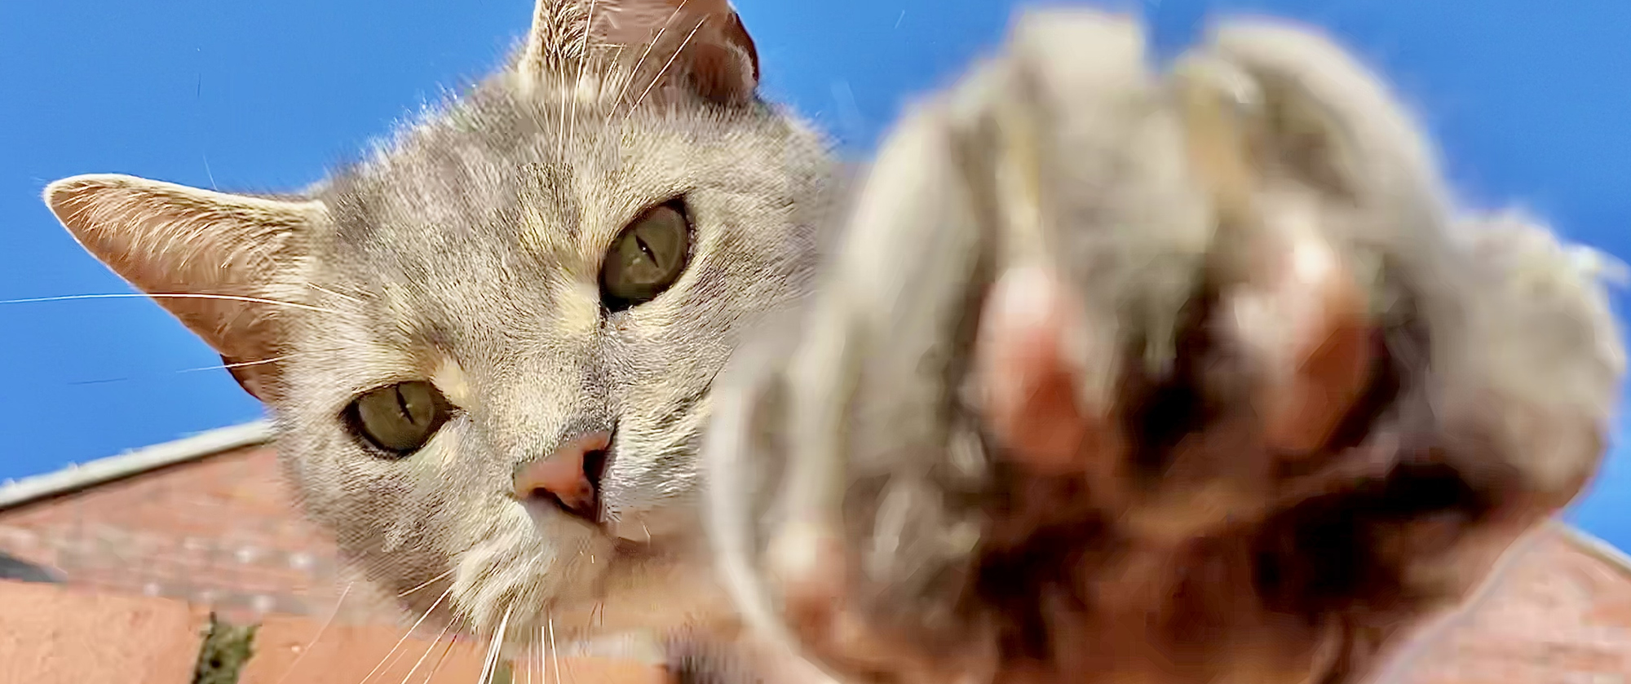
Your turn… 21
Notes:
Insert graphic
We’re going to pause and give YOU the opportunity to take part.

Slide 35
Your turn… 3
As a ________,
I will _________
in order to ________
and then with my team we will ________.
Notes:
In the next three minutes why not think of a example action using this template.
First you describe a role and level of accessibility awareness.
Then suggest an action
And describe its outcome
And then add how it will feed into a team activity

Slide 36
Your turn…
As a person wanting general awareness,
I will turn on accessibility checking in MS products
in order to identify and resolve issues as I work
and then with my team we will share experiences, lessons and tips.
Notes:
For example… read slide.

Slide 37
Your turn… 3
As a ________,
I will _________
in order to ________
and then with my team we will ________.
Notes:
So we’ll give you three minutes, post your suggestions in the chat. Even if you don’t have time to finish, keep a note of it as we’ll return to this later.
And while you work on this we’ll check if there’s any questions in the chat, and if there aren’t any we’ll ask George to help us fill in the time.

Slide 38
Level 1 (general awareness) examples
For everyone
Complete our basic level training course and…
For developers
Refresh basics using the Teach Access tutorial and…
Give a 5 to 15-minute presentation within your team about an aspect of your experience with accessibility and…
For support specialists
Review the VPAT / Accessibility Roadmap for a service your team supports and…
Review the accessibility statement of a service your team supports and…
Notes:
Matt: Here are some more examples of objectives at the general awareness level, separated by role type. These are just high-level on this and the following slides. We’re just sharing the starting point which is why each line ends with and…
For everyone we have a basic level training course. We don’t just want people to complete it, but to reflect on what they learn and discuss in a team meeting or with a colleague, and perhaps reflect three months later on how what they learned affected their day to day to work.
Developers are expected to have knowledge of modern HTML, CSS, and JavaScript and its impact on accessibility. It’s in their role’s person specification. So they should be starting at a higher level already, there’s a useful tutorial on the Teach Access website to refresh the basics, and we might want them to reflect on their experiences in a team meeting, perhaps in the form of a presentation. It doesn’t have to be a good experience, we can learn a lot from when things go wrong too.
For support specialists it’s important they understand to what extent the services they support meet accessibility guidelines because they tend to be service owners. So understanding VPATs, accessibility roadmaps and statements is a good start, especially replicating errors, or validating the truthfulness of these statements. Just doing these exercises is likely to lead to discoveries that can be fed back within the support team and to the vendor, be they internal or external.

Slide 39
Level 2 (discovering) examples
For everyone
Learn how to use the accessibility checking features in office and…
For developers
Test a site or component you have created using W3C Easy Checks and…
For support specialists
Review local documentation / help guides for a service supported by your team for accessibility and…
Create an accessibility statement for a service supported by your team
Set up Outlook so that correspondents are alerted if they try to send you an email with accessibility issues.
Learn about three WCAG success criteria and their “sufficient techniques” and…
Notes:
Here’s some level 2 examples, again at a fairly high level of detail, here we are at the discovering stage.
At the generalist level we want people to become confident using accessibility checking features in office and resolving defects in content.
For developers we want them to go a bit deeper in testing, starting with the W3C’s easy checks. It can also be very useful not only to learn about some success criteria but you can get a deeper understanding by studying the “sufficient techniques” for meeting them. We might then ask them to give a demonstration or presentation to colleagues at a team meeting and then lead a discussion.
Support specialists can start reviewing their support guides and documentation and revising them for accessibility, for example using semantic ordered lists for step by steps, and using “select” rather than “click” within written instructions. Commercial off the shelf services with VPATs should make writing accessibility statements fairly straightforward.
Again they should be feeding back lessons to their teams, feeding forward to vendors and so on.

Slide 40
Level 3 (exploring) examples
For everyone
Consider your own working practices and behaviours, identify how to change them so that the work your produce is more accessible and…
For developers
Observe how a user with a disability or impairment uses your service, discuss potential improvements and…
For support specialists
Promote how assistive technology works with a service supported by your team on Global Accessibility Awareness Day and…
Notes:
Here’s a light overview of some level 3 – exploring objectives.
We might ask generalists to reflect on their own working practices and behaviours and look for how small changes may result in more accessible or inclusive outcomes.
We might also ask developers or support specialists to work with staff or students with disabilities, observe how they use the services for which they are responsible, and then talk through potential improvements, or promote how assistive technology works with a University service. Most of our support specialists have not yet tried using a service they own with a keyboard or screen reader.
Still all these are very high level, to give you an idea, obviously these are not written out as SMART objectives.

Slide 41
Level 4 (advocating / championing) examples
For everyone
Share your accessibility lessons to the wider department, University, to an external audience and…
For developers
Work with a level 5 software engineer or accessibility expert in a pair-programming scenario and…
For support specialists
Meet our Disability Staff Network, or Student Union, and reflect with them upon the improvements your team has made to the accessibility of a service your team supports and…
Notes:
At the final level we’re looking for people to share their lessons, good or bad with the wider department or external audiences.
Building up that organisational culture, pair programming where a developer with more accessibility experience works with another developer can be a good way to work through accessibility puzzles.
Building on partnership, support specialists by this point should be building a close working relationship with staff and student groups.

Slide 42
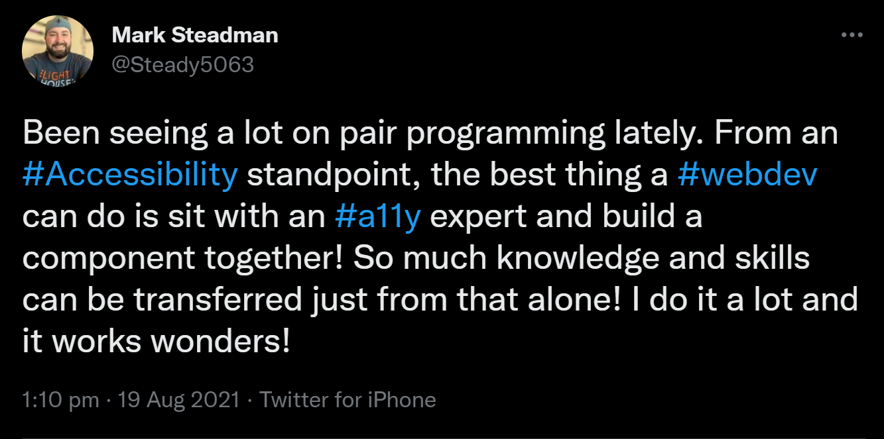
Pair programming
Notes:
Pair programming has been recommended by Mark Steadman who is the Principal Accessibility Engineer at Fidelity Investments. Last year he tweeted that he found as an accessibility consultant that sitting with developers and creating a component together is a great approach and learning opportunity.
By the way, make sure to read his award winning posts on dev dot to
https://dev.to/steady5063

Slide 43
Progress
To do
In progress
Done
Review and quality check objectives.
Publish and raise awareness.
Monitor progress, iterate and update
Support Specialist Level 2 to 4 objectives.
Objectives for other roles.
First draft of
Universal Level 1 to 4 objectives.
Developer Level 1 to 4 objectives
Support Specialist Level 1 objectives.
Notes:
In terms of progress we have a first draft for about two thirds of the initial content we planned.
[progress]
And we’re slowly working our way to completing that final third of the first draft.
[progress]
This need to be reviewed and quality checked, and then confidence checked with a wider circle of colleagues. Assuming we get the go-ahead we will publish internally and begin raising awareness. Hopefully we will get lots of feedback and ideas for next steps so we can monitor progress and iterate further.

Slide 44




Challenges
Writing objectives is hard!
Will they be used?
How can we measure success?
Can we involve our user community more in writing them?
Notes:
Tamsyn: It has been a challenge
After an initial sprint of activity our pace has slowed. Writing objectives is hard!
[progress]
We also don’t know for sure whether there will be take up, but since writing objectives is hard if we can give line-managers some quick wins then these may be popular.
[progress]
We’re not sure yet how we can objectively measure take up and outcomes. Appraisals are confidential between a direct report and their line-manager.
[progress]
We’re also going to be talking more to our disability staff network, and student groups to ask for feedback on these ideas. We’re particularly concerned to get buy-in from them and not end up with our colleagues randomly asking the same groups of people for similar feedback.

Slide 45



Opportunities
Wish to share with the wider community.
Already had some indications of management buy-in.
Promising potential.
Notes:
On the plus side. We’ll be sharing next a draft of the work so far. And once complete we’ll be sharing this work through Creative Commons to the accessibility community.
[progress]
We’ve had a couple of managers in our department already show interest.
[progress]
And accessibility contacts we’ve spoken to so far all see a lot of potential in this concept.

Slide 46
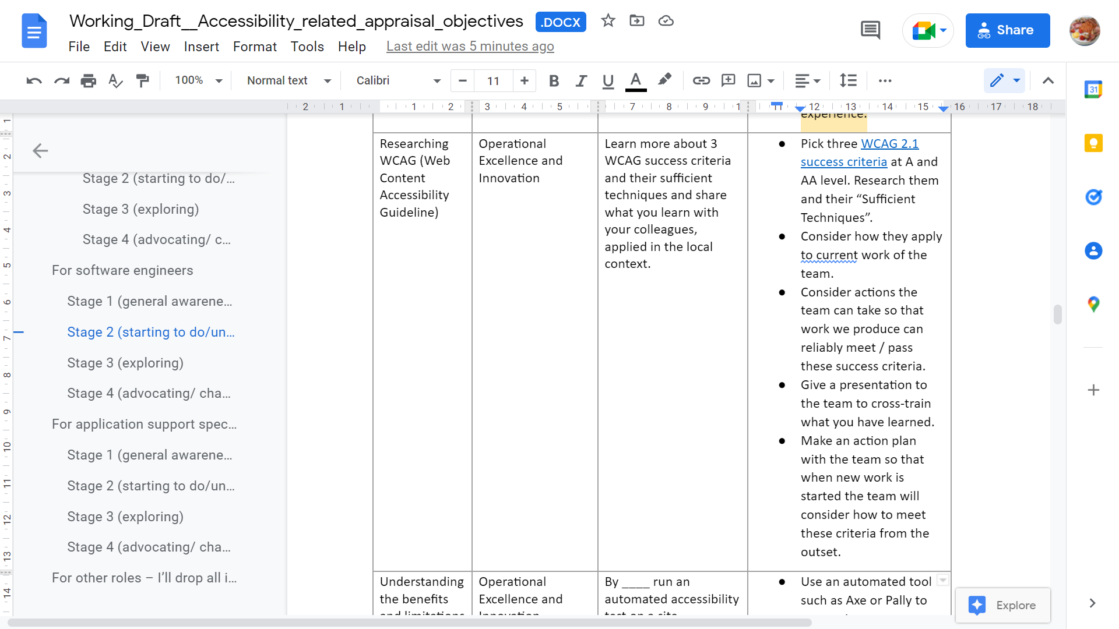
What next?
Notes:
So what’s next?
We’ve written first drafts of almost 40 objectives so far.
[Progress]
We’ve made these available as a Google doc. You’re welcome to download, view, add comments, make edits or suggestions. Keep in mind this is still an early draft and a lot more effort is needed to make these of acceptable quality in terms of being SMART, and in confidence checking that they should achieve the desired outcomes.
A document is probably not the best vehicle for this information but when we make it more widely available we expect to share it on github with a creative commons licence.
Why not develop your idea from earlier, and consider writing it up into a SMART objective and adding it to the document?
-----

Slide 47

Discussion
Notes:
Thanks for listening to us today. We’re happy to open up now for discussion.

